Slide 1



Project Presentation
By Rishikesh Kumar

Slide 2

Title
Securing Web Application Infrastructure:
A Multi-Layered Approach

Slide 3
Description
This project builds a layered security shield around a web application so no single flaw can compromise it. Instead of relying on one control, several barriers work together to block and reduce risks. The first layer filters incoming connections, allowing only trusted traffic while rejecting suspicious requests. A second layer inspects requests in depth, blocking malicious code, hacking attempts, and harmful patterns before they reach the server. Inside the network, the application and services run in an isolated zone, so even if defenses are bypassed, attackers cannot move freely or affect other systems. Continuous monitoring acts like a watchtower, collecting and analyzing logs, traffic, and activities in real time to detect threats early and allow a quick response. By blending these elements, the design follows the defense-in-depth approach: Block threats at the door, Inspect what gets through, Contain critical services, And watch everything in real time.

Slide 4
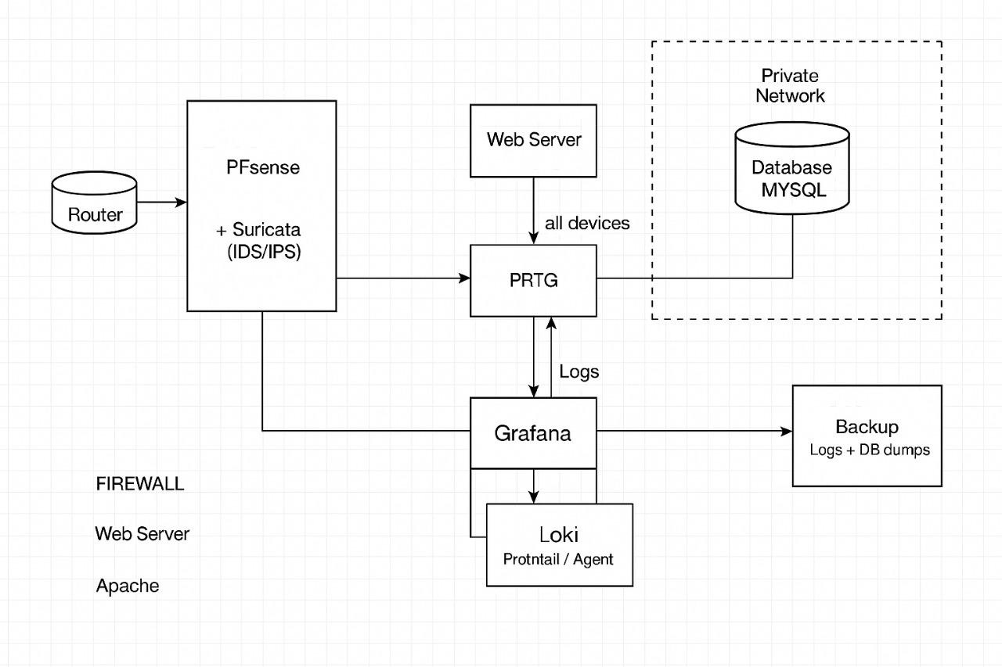
Architecture

Slide 5
Monitoring Implementation
Tools Used: PRTG, Grafana, Loki, Promtail
PRTG - Monitoring the network & the Infrastructure
Grafana - Logs Visualization
Loki - Data warehouse
Promtail - Logs Shipper/ Agent

Slide 6
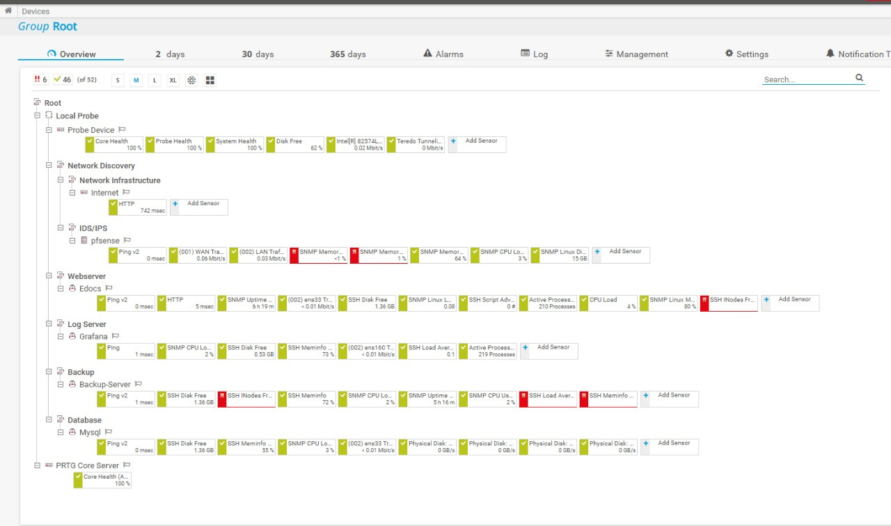
PRTG
Monitoring Implementation

Slide 7
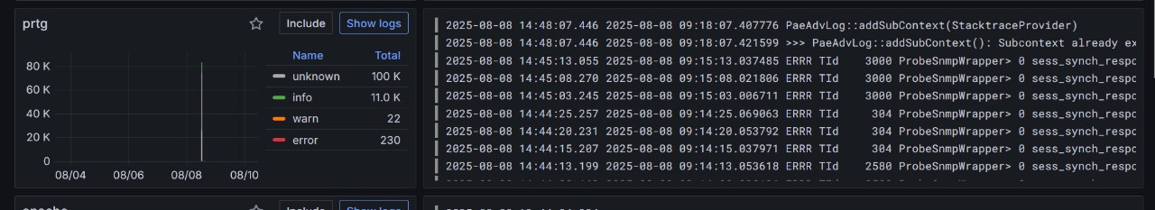
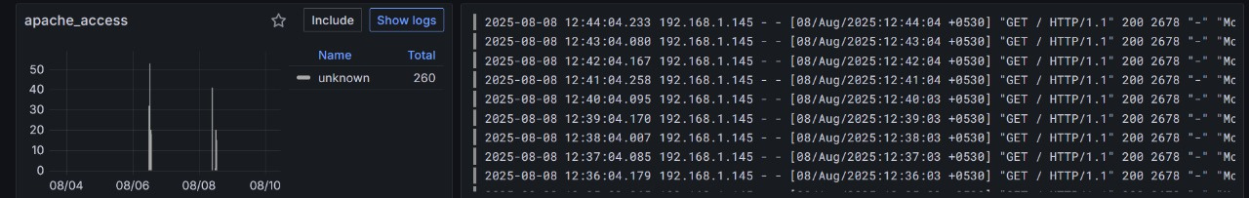
Grafana
Monitoring Implementation
Prtg
Apache

Slide 8
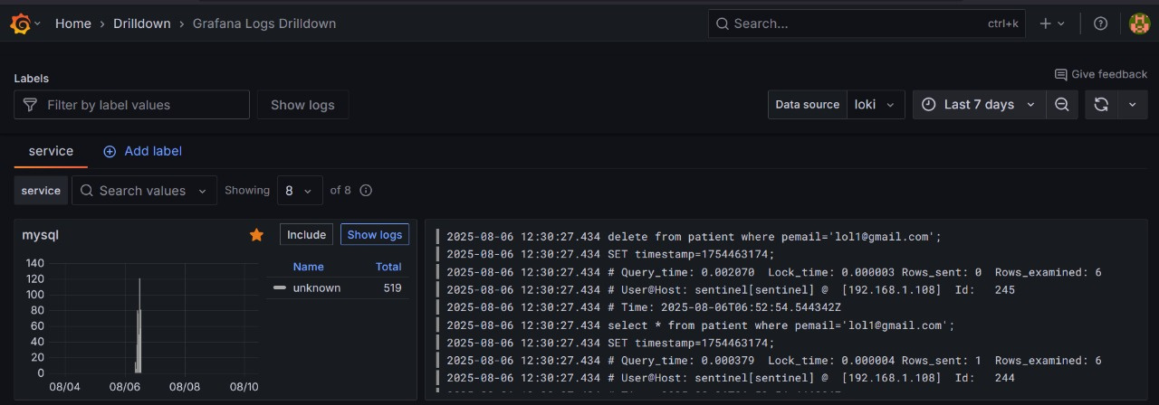
Grafana
Monitoring Implementation
Mysql

Slide 9
Suricata
IDS/IPS
Suricata is an open-source network threat detection engine that functions as an IDS (Intrusion Detection System), IPS (Intrusion Prevention System), and network security monitoring tool. It analyzes network traffic in real time using signature-based and anomaly-based detection, supports multi-threading for high performance, and can log detailed alerts about malicious activity.

Slide 10
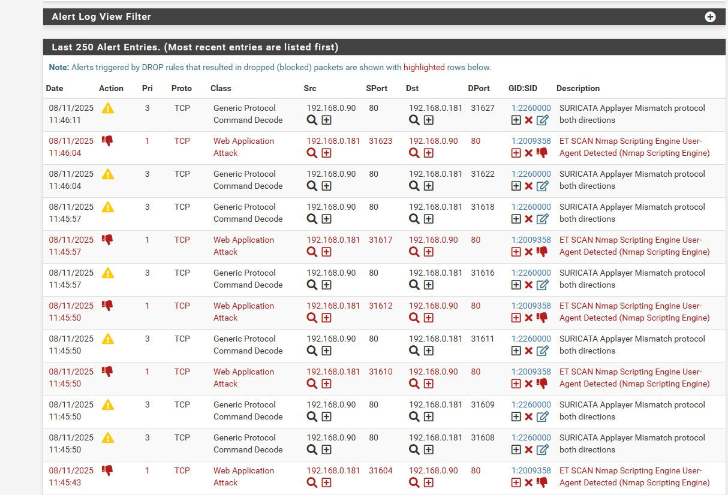
Suricata
IDS/IPS

Slide 11
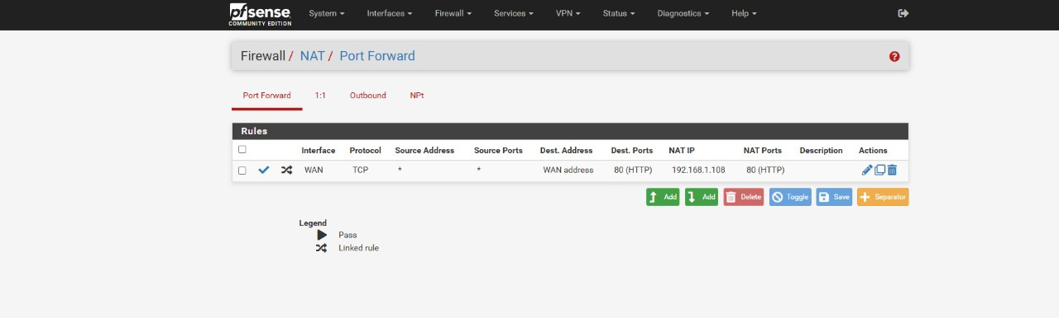
Suricata
IDS/IPS

Slide 12
Backup Server
RSYNC with Chronicle

Slide 13
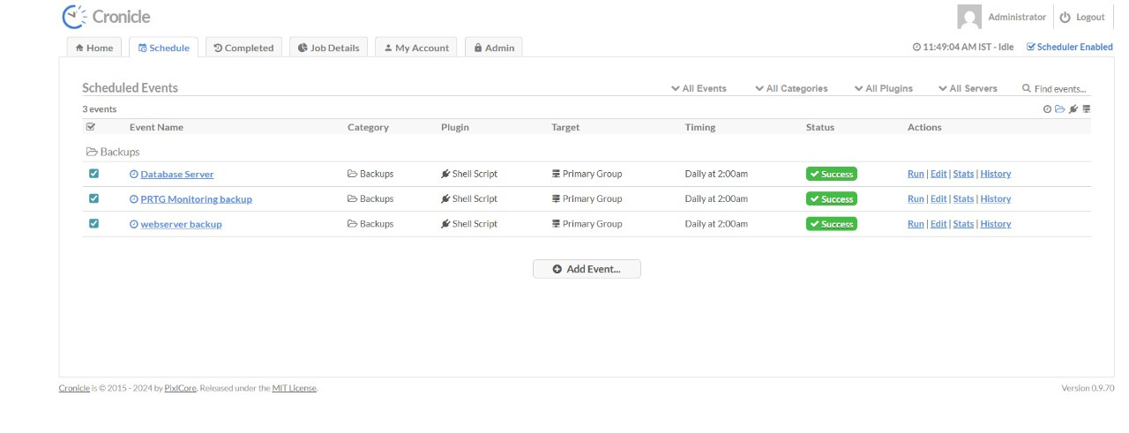
Backup Server
RSYNC with Chronicle

Slide 14
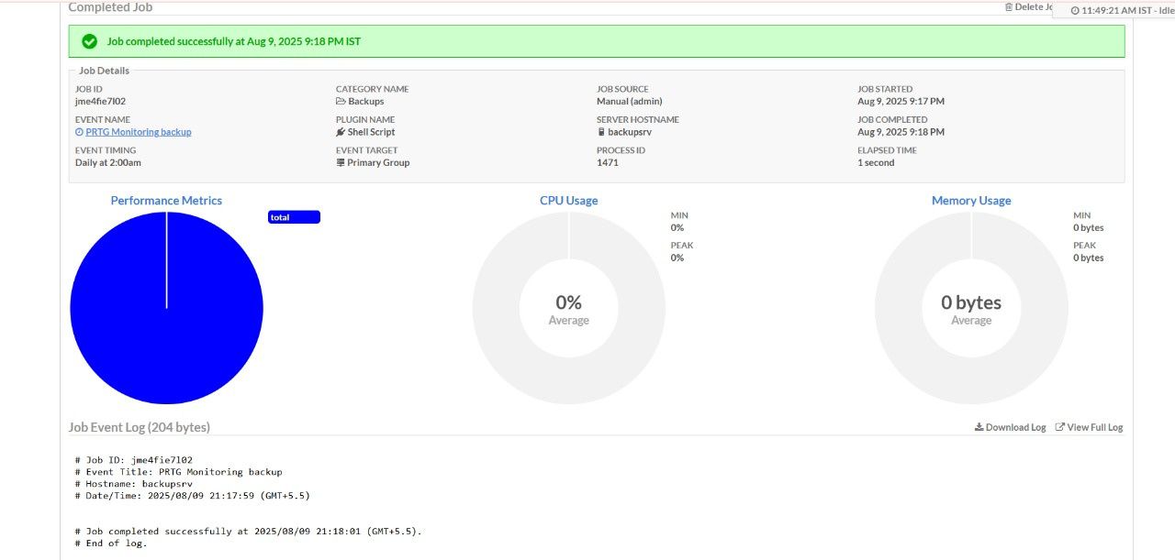
Backup Server
RSYNC with Chronicle

Slide 15
Web Server
Apache
A widely used open-source web server for delivering secure and scalable websites or applications.

Slide 16
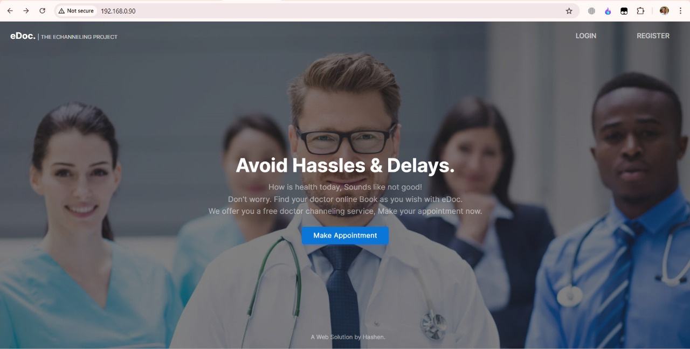
Web Server
Apache

Slide 17
Mysql
Database Server
An open-source relational database system used to store, manage, and query application data efficiently.

Slide 18
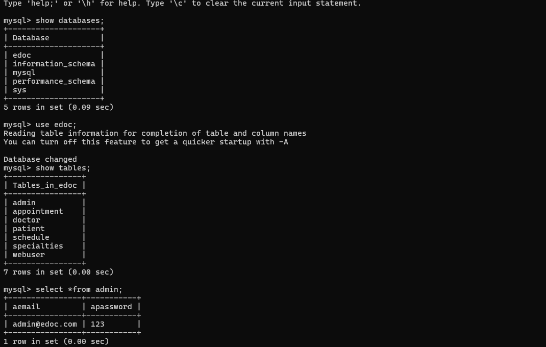
Mysql
Database Server

Slide 19
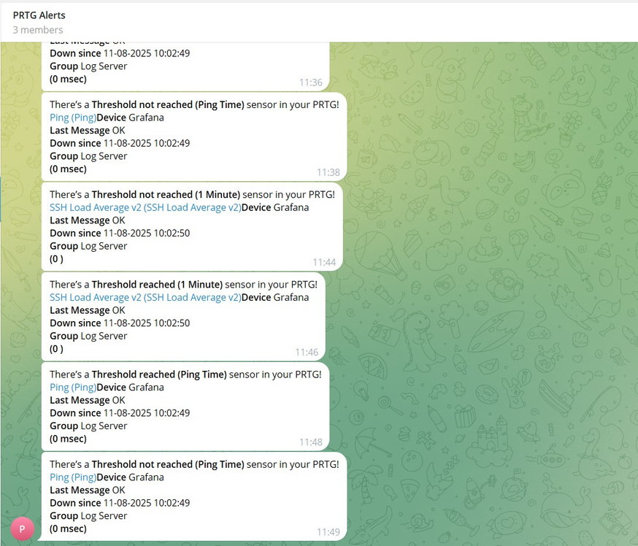
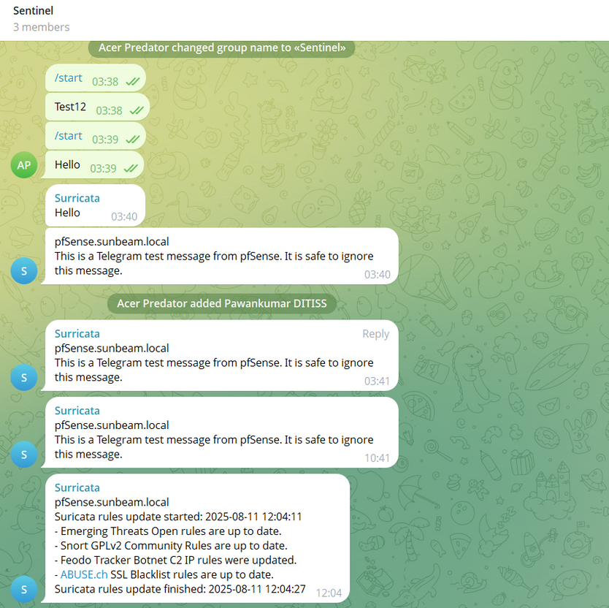
Monitoring Implementation
Alerts

Slide 20
Challenges & Solutions
Challenge: False positives in IDS → Solution: Custom rule tuning
VMware corruption — One of the virtual machines became corrupted, affecting service availability. → Recovered the VM from a backup snapshot and implemented a regular backup schedule to prevent future data loss.
PRTG setup complexity — Initial setup was difficult due to SNMP configuration and firewall rules blocking data collection. → Configured proper SNMP community strings, opened necessary ports in firewall, and tested connectivity step-by-step.

Slide 21
Outcomes & Benefits
Increased visibility into infrastructure
Learned about networking in detailed
Reduced risk from attacks
Reliable recovery from data loss

Slide 22
Conclusion
Integrate automated incident response
Add load balancing to web services
If the application increases moving towards the devops.
This project demonstrates end-to-end IT infrastructure security, monitoring, and resilience."

Slide 23
Project Members
Ankur Garg
250244223008
Mayuri Bhalerao
250244223010
Pawankumar Shedage
250244223041
Rishikesh Kumar
250244223043

Slide 24
Thank You

